Slide 1
ML for the .NET Developer
Raleigh Code Camp
Jamie Dixon
10/29/2016

Slide 2
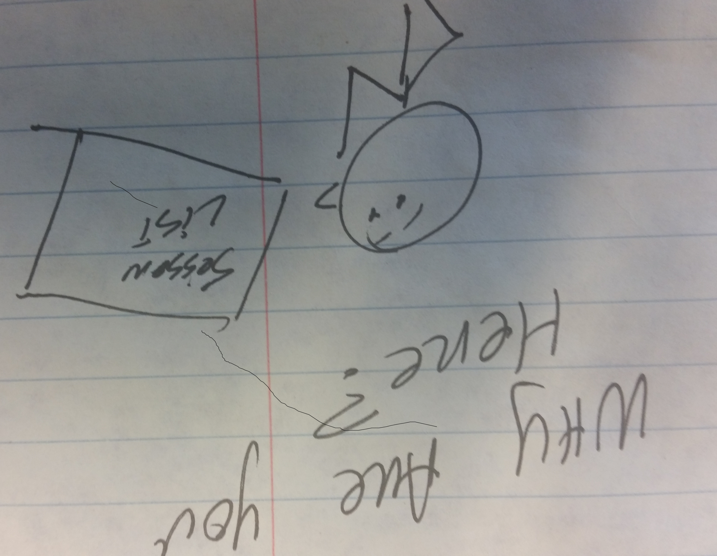
You Are:
A developer wanting to learn about making your applications smarter: the intelligent app is moving CRUD to RIP*
A research analyst/data engineer/report writer being asked to move from descriptive analytics to predictive analytics. “Data Scientist”
Someone who wandered in because the other sessions were full and/or did not look as interesting
*Recommend, Instruct, Predict
Notes:
Recommend
Instruct
Predict

Slide 3
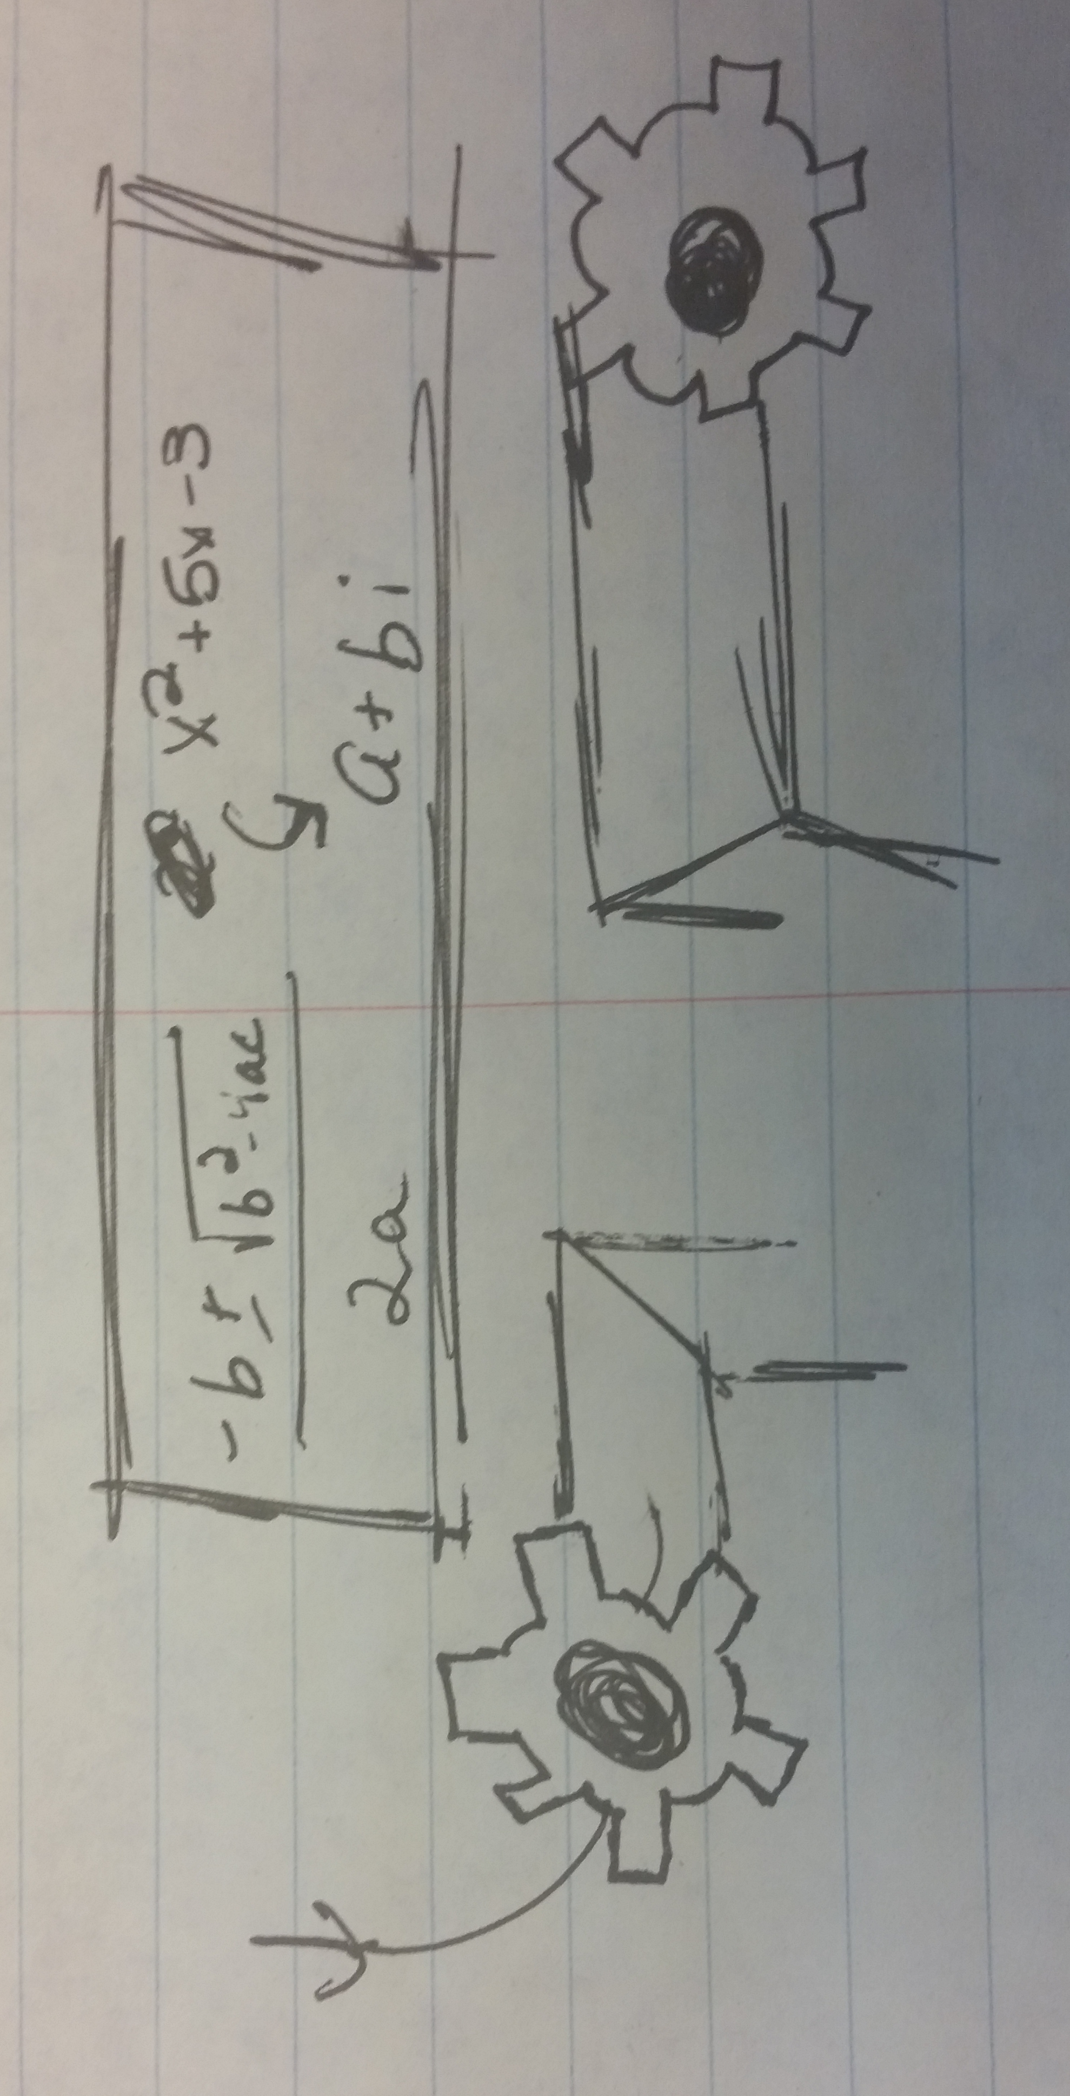
What is Machine Learning?
A technique to train models
A way for applications to change behavior without recompiling.
I, for one, welcome our new overlords
A way for companies to monetize their existing data
A way for cranks to sell more books
Notes:
Yes
No – that is “Intelligent Apps”
No – that is a data science strategy
No – would never lower myself to push out a book to take advantage of a hot buzzword

Slide 4
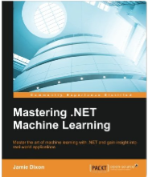
A Word About “Machine Learning”

Slide 5
Data Science Process
Most important step: Ask Question
Most time-consuming step: Prepare Data
Step most likely to get wrong: Test Model
Ask Question
Prepare Data
Select Model
Train Model
Test Model
Conclude
Notes:
ML is in the training of the model

Slide 6

A Word About “Conclude”
Used to look at it and perhaps change
Ad-hoc analysis
Weights were put into prod
Now, more likely to be retrained
Analyze data in motion: Stream processing
Analyze data at rest: Batch processing

Slide 7


Ready For ML?
ETL -> ELt
Question is clearly defined (“sharp”)
Data matches the question
Data is accurate
Have enough data?

Slide 8





On-Prem Desktop
Use Excel – Analytics Tool pack
Use Power BI
Tableau
Rapid Miner
jmp
Notes:
Excel Example

Slide 9





On-Prem Server
SAS
MatLab
Stick to the Main Frame (Cobol, FORTRAN)
SQL/RServer
Hadoop and/or Spark (Mahout or pyspark)
Notes:
R Server Example

Slide 10
Cloud
IaaS – Infrastructure
PaaS – Platform
SaaS – Software

Slide 11
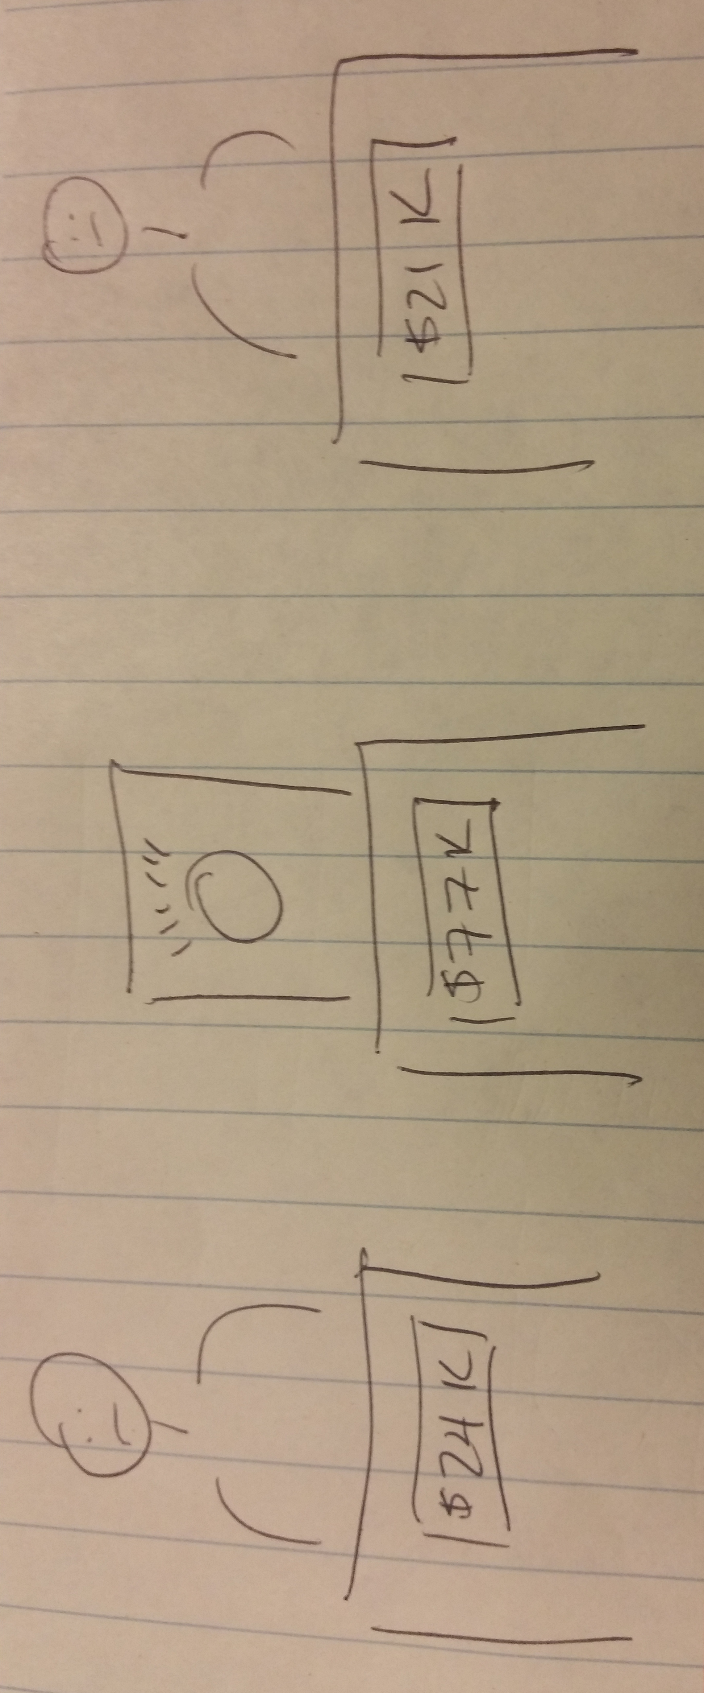
Watson
Notes:
http://www.ibm.com/watson/
Machine Learning as an api:
Language translation
Question and answer for travel and health care “Does this look infected to you?”
Visualization Rendering
https://watson.analytics.ibmcloud.com/
Machine Learning as a service: Watson Analytics
Take data and provide insights
Example
https://www.ibm.com/analytics/watson-analytics/us-en/index.html
jamie@chickensoftware.com
1q2w3e4r

Slide 12
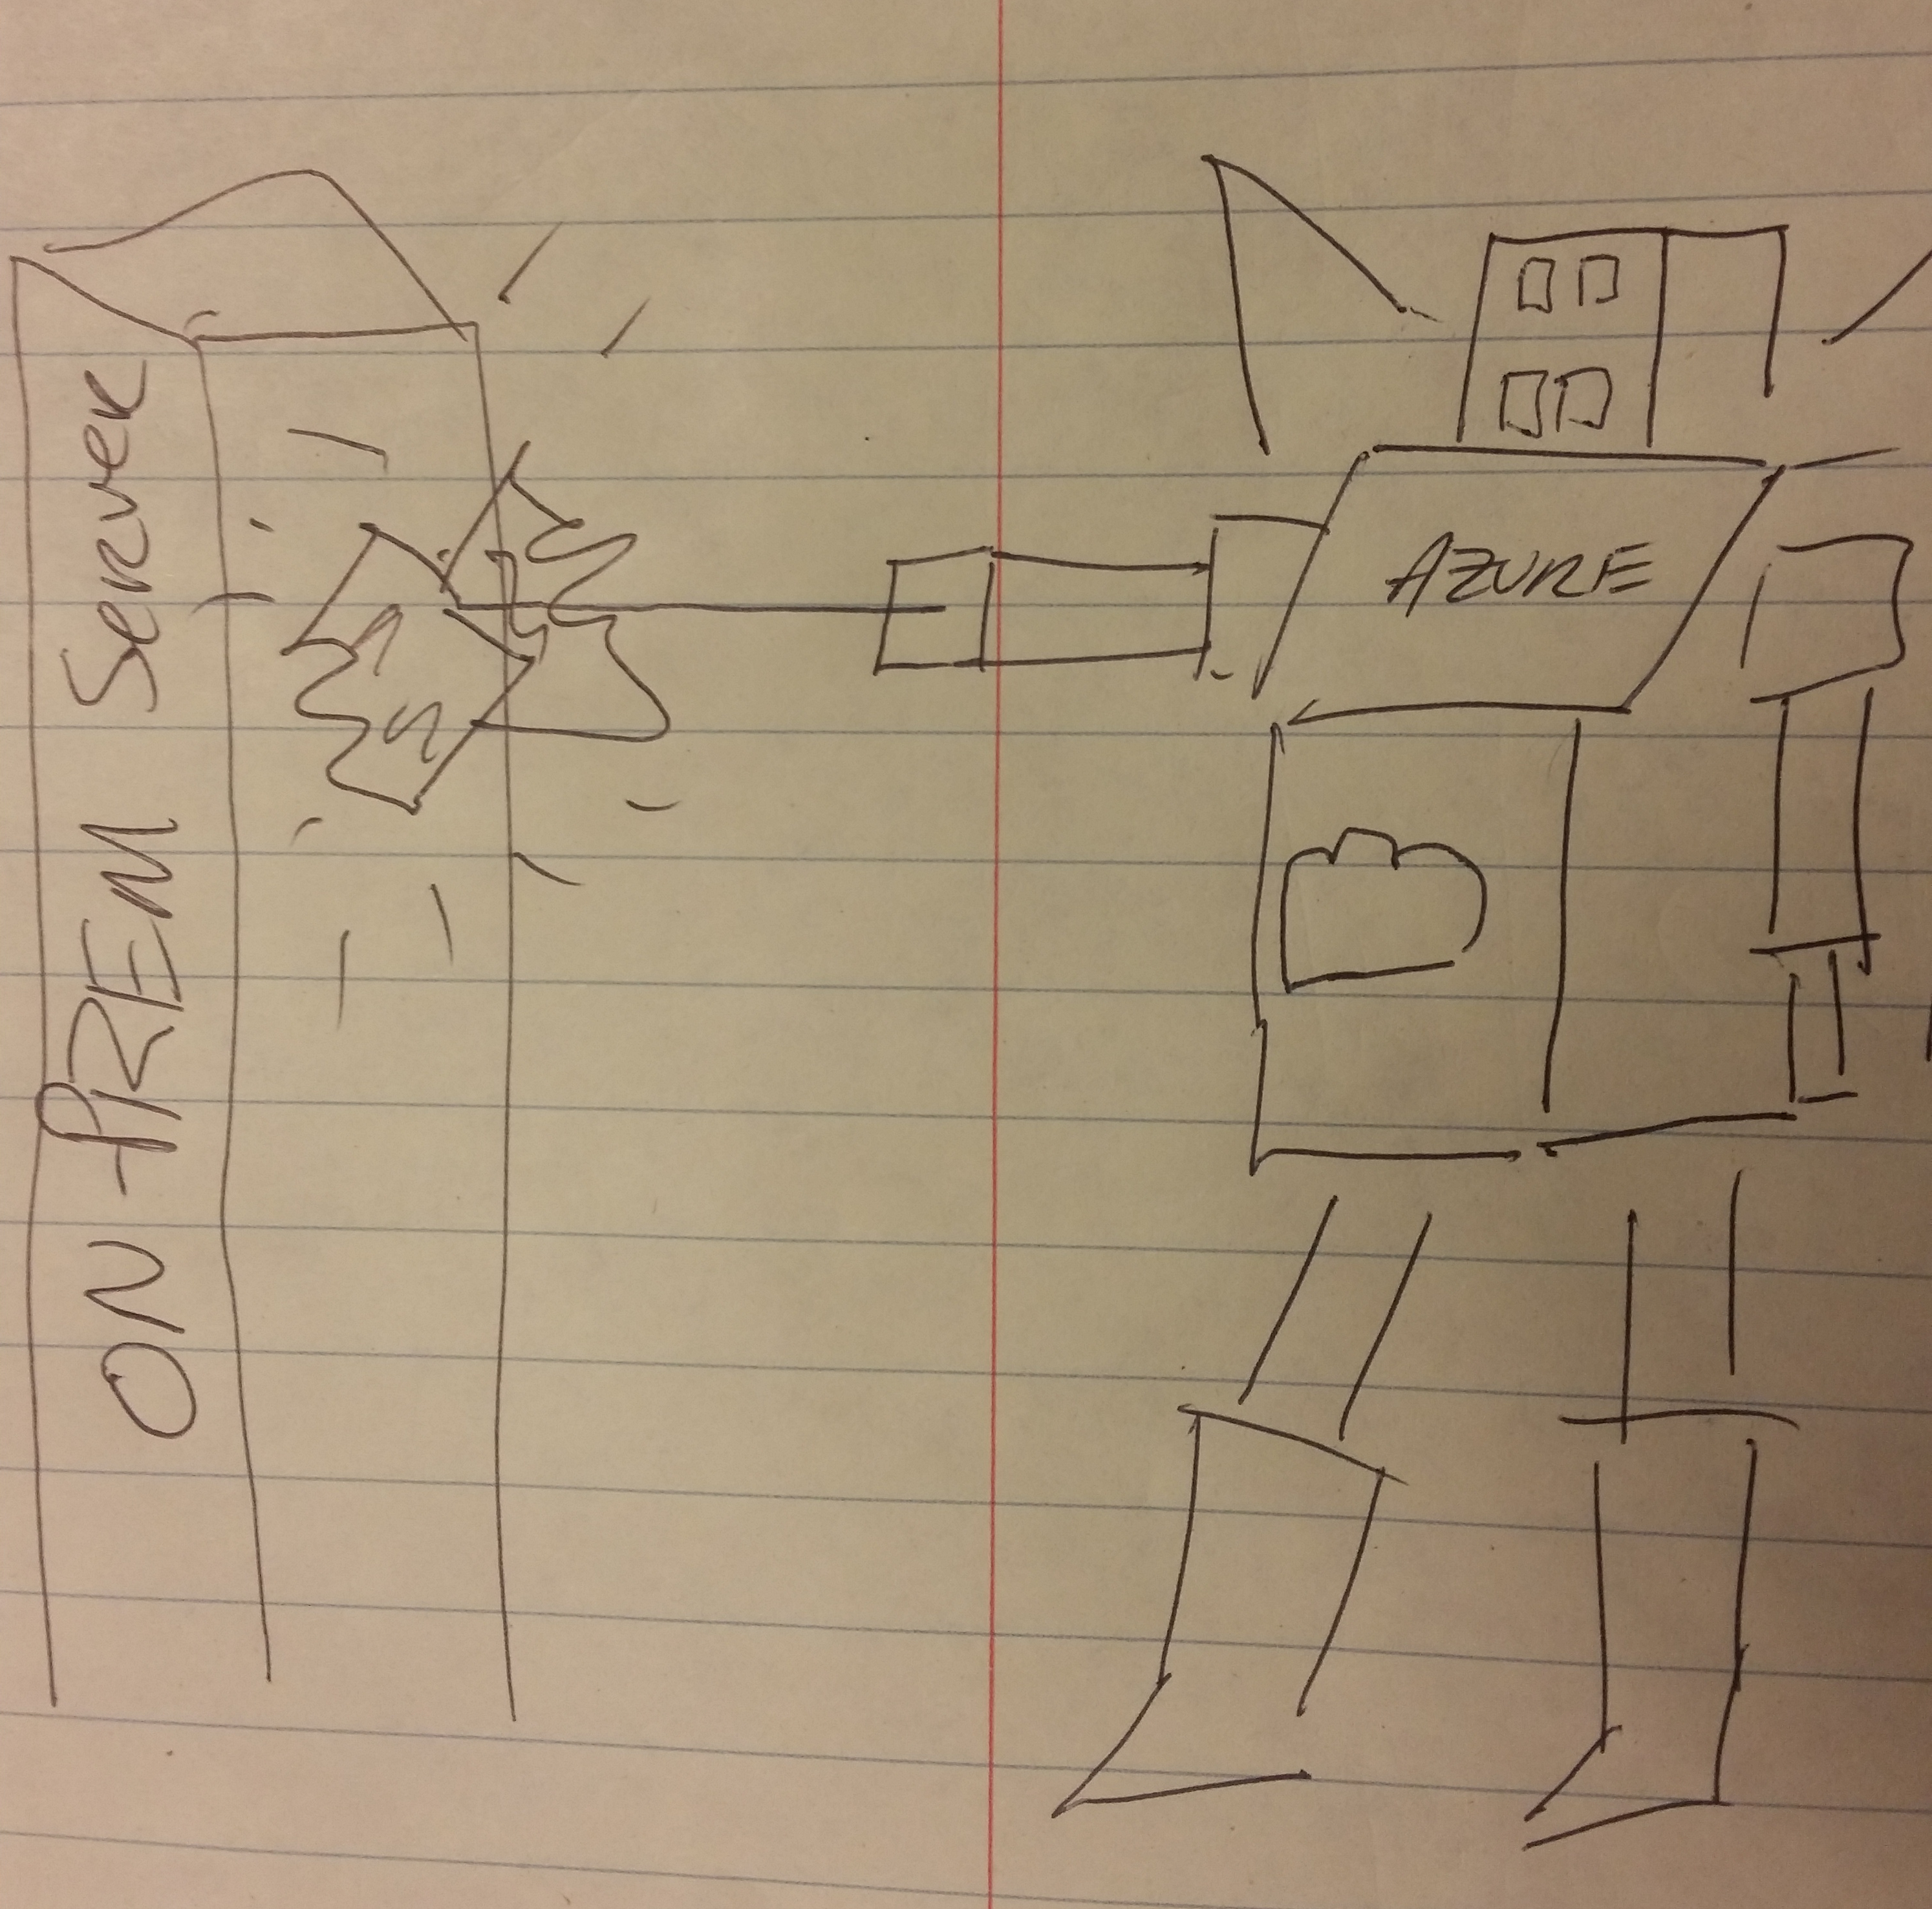
Azure
Notes:
Example
Cognitive Services Api:
https://www.microsoft.com/cognitive-services/
Speech conversion and translation
Facial recognition ~ Emotion, face,
Language understanding
Recommendation engine
Azure ML
https://studio.azureml.net/
“Drag and Drop” data science

Slide 13
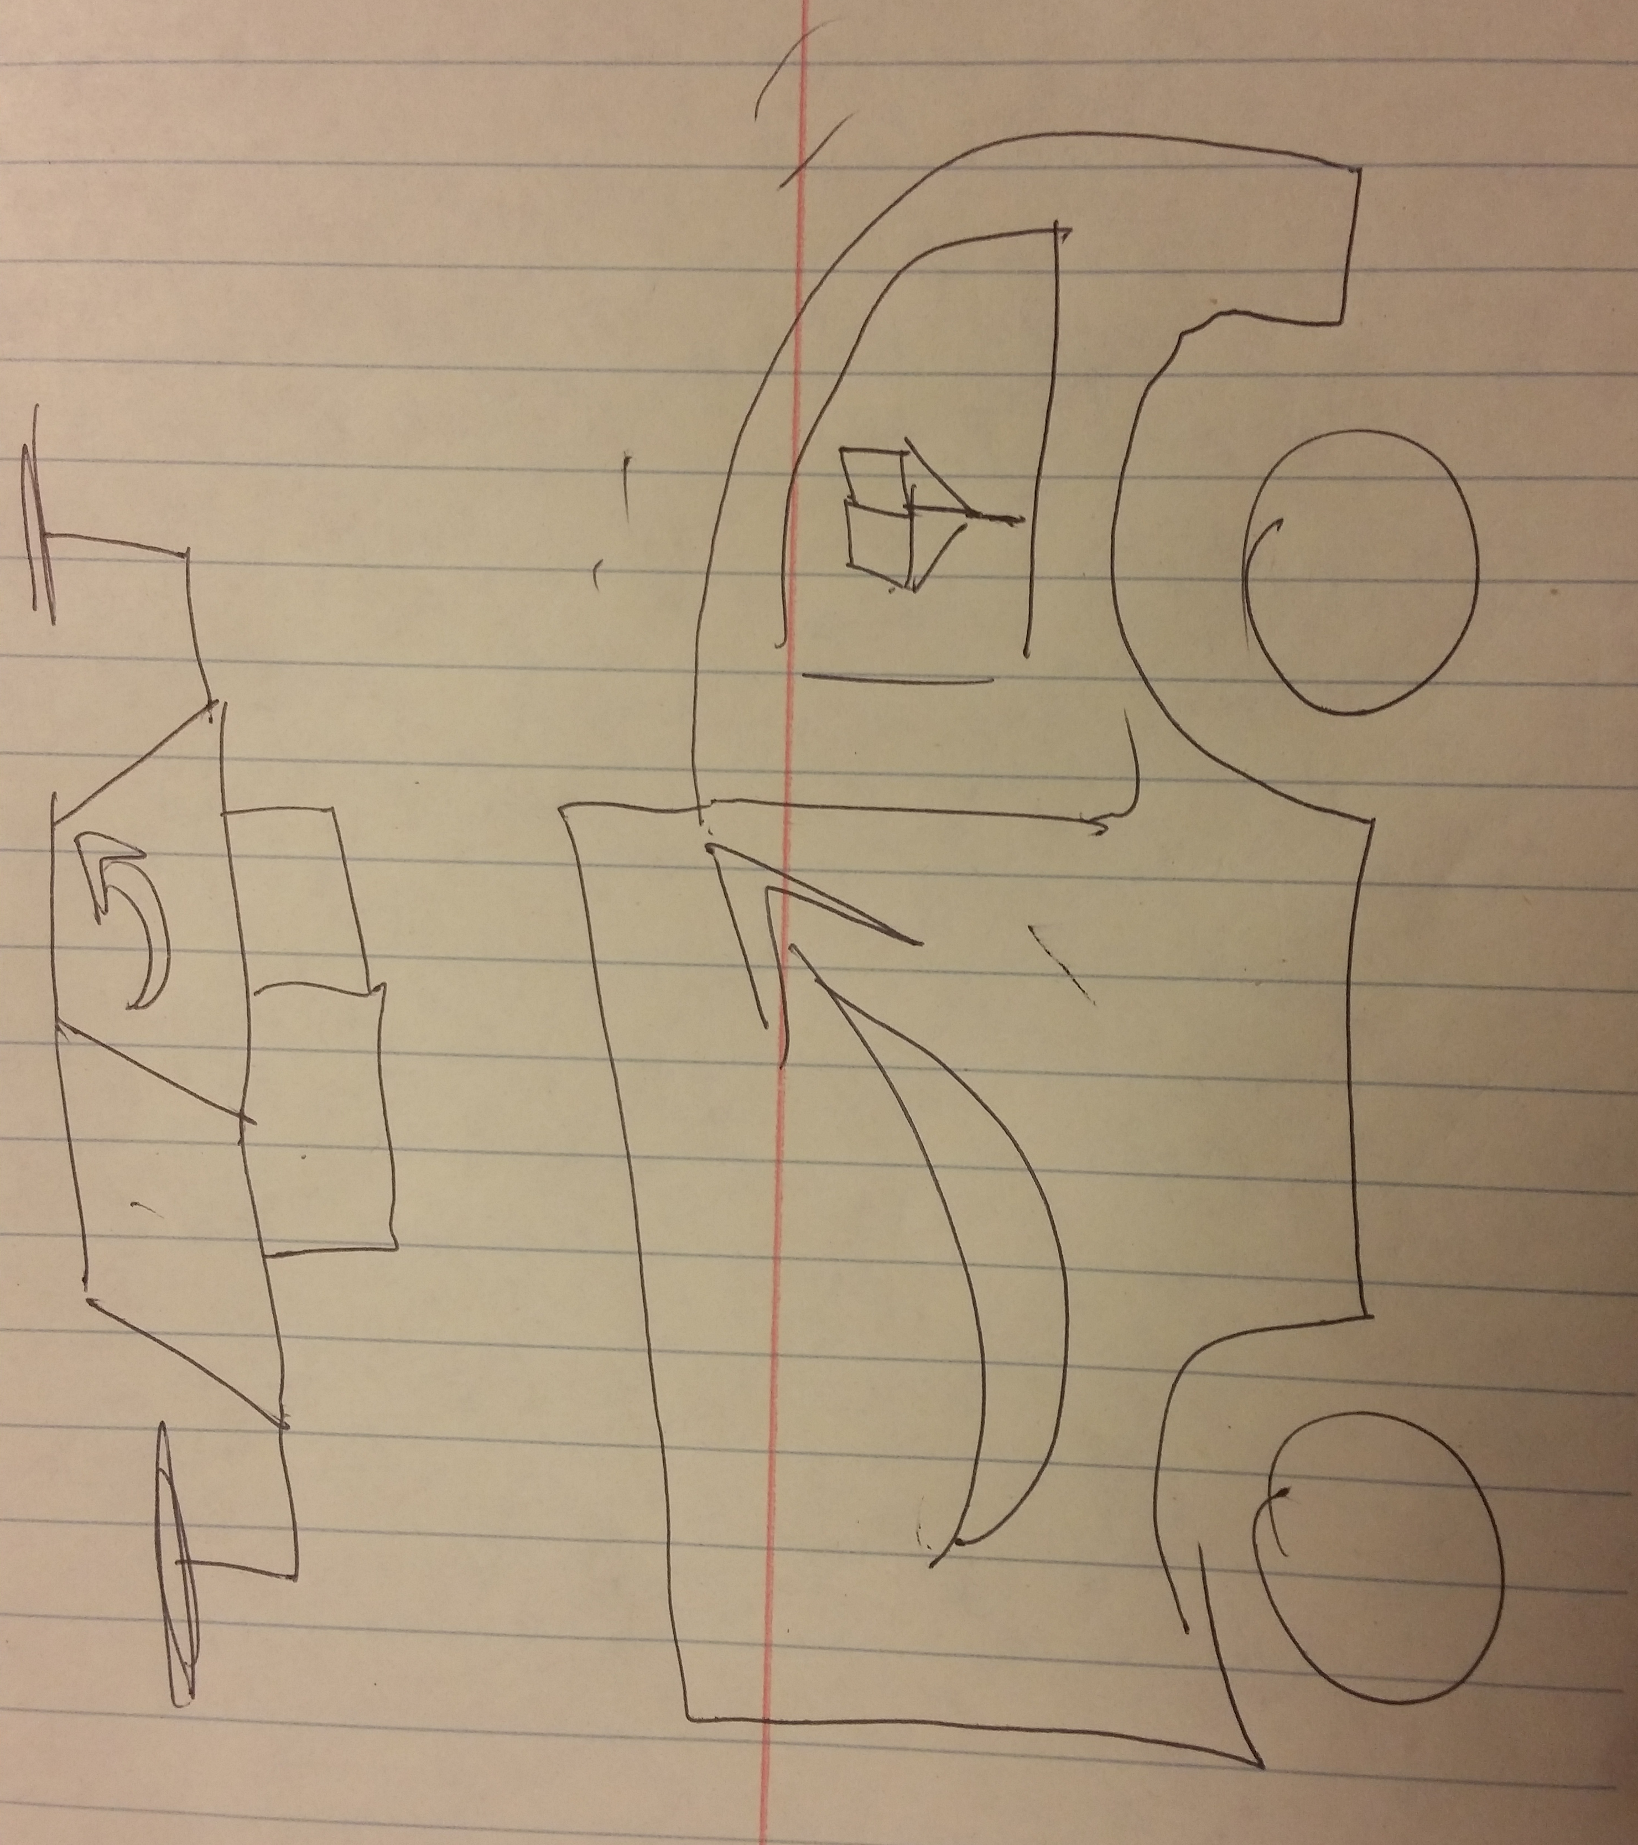
AWS
Notes:
Example
https://console.aws.amazon.com/machinelearning/home?region=us-east-1#/
jamessdixon@gmail.com
83robincircle

Slide 14

.NET
Accord .NET
Numl
Encog .NET
Alglibnet
MBrace
Notes:
http://accord-framework.net/
http://numl.net/
http://www.alglib.net/
http://www.heatonresearch.com/encog/
http://mbrace.io/

Slide 15
Conclusion
Nail the question, the rest will follow
The more willing you are to learn, the better off you will be
Companies are not “one tool away” from a strategic advantage, but they might be “one team away”
@jamie_dixon
https://github.com/jamessdixon/Trinug.CodeCamp.Oct2016

